Slide 1
JAVA Variables, Data types, Operators and keywords
Prepared By: Dimple Bohra

Slide 2
Java Variables
A variable is a container which holds the value while the Java Program is executed. A variable is assigned with a data type.
Variable is a name of memory location. There are three types of variables in java:
Local
Instance
Static.

Slide 3
Example
class A
{
int data=50;//instance variable
static int m=100;//static variable
void method()
{
int n=90;//local variable
}
}//end of class
Notes:
1) Local Variable
A variable declared inside the body of the method is called local variable. You can use this variable only within that method and the other methods in the class aren't even aware that the variable exists.
A local variable cannot be defined with "static" keyword.
2) Instance Variable
A variable declared inside the class but outside the body of the method, is called instance variable.
It is called instance variable because its value is instance specific and is not shared among instances.
3) Static variable
A variable which is declared as static is called static variable. It cannot be local. You can create a single copy of static variable and share among all the instances of the class. Memory allocation for static variable happens only once when the class is loaded in the memory.

Slide 4
Data Types in Java
Data types specify the different sizes and values that can be stored in the variable. There are two types of data types in Java:
Primitive data types: are readily available for programmer’s use.
Non-primitive data types: are generally made up of multiple primitive data types.

Slide 5
Primitive Data Types
Primitive data types are the building blocks of data manipulation.
These are the most basic data types available in Java.
There are 8 types of primitive data types

Slide 6
Primitive Data Types
Data Type | Size | Description
byte | 1 byte | Stores whole numbers from -128 to 127
short | 2 bytes | Stores whole numbers from -32,768 to 32,767
int | 4 bytes | Stores whole numbers from -2,147,483,648 to 2,147,483,647
long | 8 bytes | Stores whole numbers from -9,223,372,036,854,775,808 to 9,223,372,036,854,775,807
float | 4 bytes | Stores fractional numbers. Sufficient for storing 6 to 7 decimal digits
double | 8 bytes | Stores fractional numbers. Sufficient for storing 15 decimal digits
boolean | 1 bit | Stores true or false values
char | 2 bytes | Stores a single character/letter or ASCII values
Notes:
Data Type Default Value
Boolean false
Char '\u0000’
Byte 0
Short 0
Int 0
Long 0L
Float 0.0f
Double 0.0d

Slide 7
Non-Primitive Data Types
Non-primitive data types are called reference types because they refer to objects.
The main difference between primitive and non-primitive data types are:
Primitive types are predefined (already defined) in Java. Non-primitive types are created by the programmer and is not defined by Java (except for String).
Non-primitive types can be used to call methods to perform certain operations, while primitive types cannot.
A primitive type has always a value, while non-primitive types can be null.
The size of a primitive type depends on the data type, while non-primitive types have all the same size.
Examples: Strings, Arrays, Classes ,Interfaces etc.

Slide 8
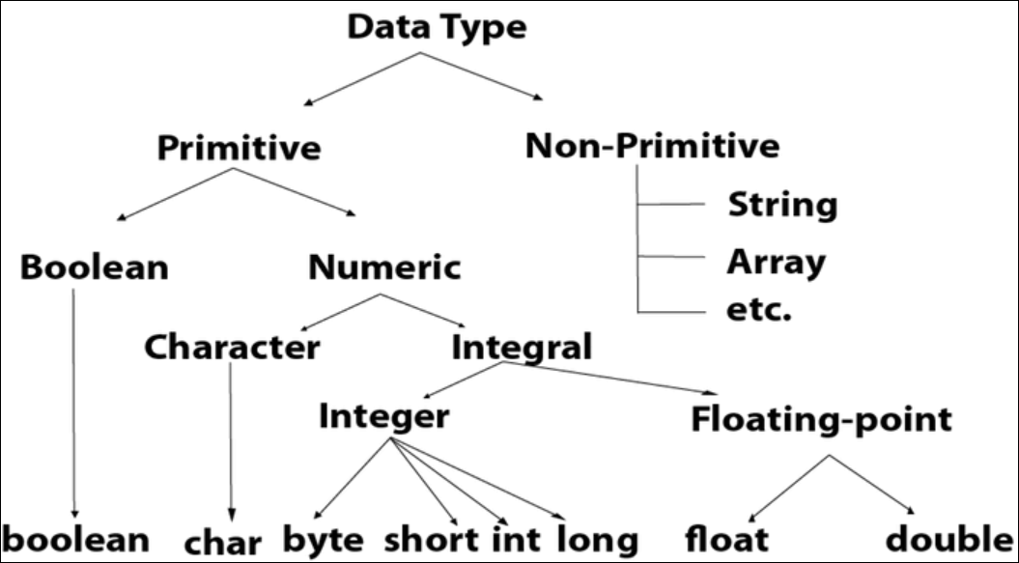

Slide 9
Java Type Casting
Type casting is when you assign a value of one primitive data type to another type.
In Java, there are two types of casting:
Widening Casting (automatically) - converting a smaller type to a larger type size
byte -> short -> char -> int -> long -> float -> double
Narrowing Casting (manually) - converting a larger type to a smaller size type
double -> float -> long -> int -> char -> short -> byte

Slide 10
Widening Casting Example
class Sample
{
public static void main(String[] args)
{
int a = 10;
double b = a; // Automatic casting: int to double
System.out.println(a);
System.out.println(b);
}
}

Slide 11
Narrowing Casting Example
class Sample
{
public static void main(String[] args)
{
double a = 10.34;
int b = (int) a; // Manual casting: double to int
System.out.println(a);
System.out.println(b);
}
}

Slide 12
Operators in Java
Java divides the operators into the following groups:
Arithmetic operators
Assignment operators
Comparison operators
Logical operators
Bitwise operators

Slide 13
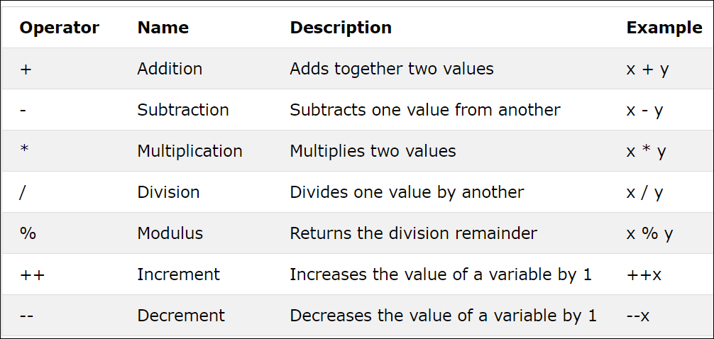
Arithmetic Operator

Slide 14
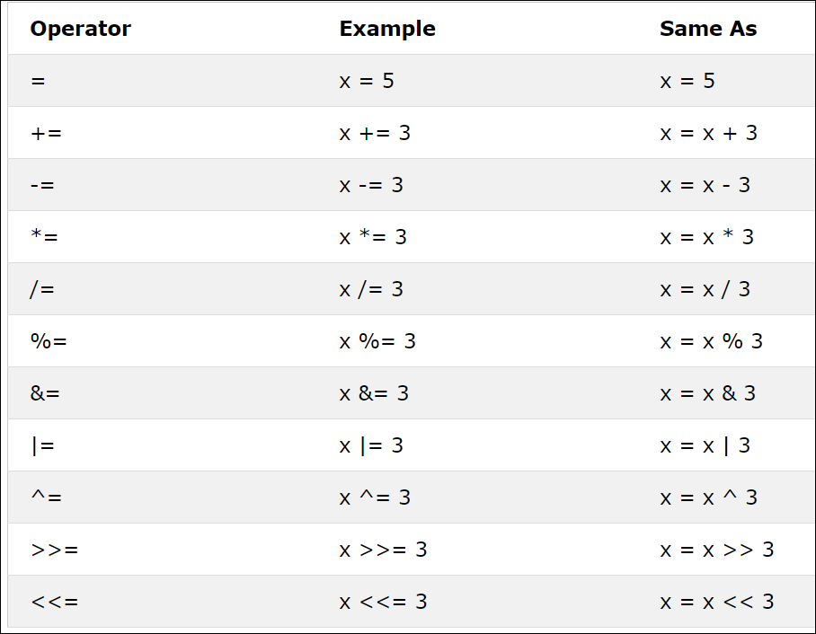
Assignment Operators

Slide 15
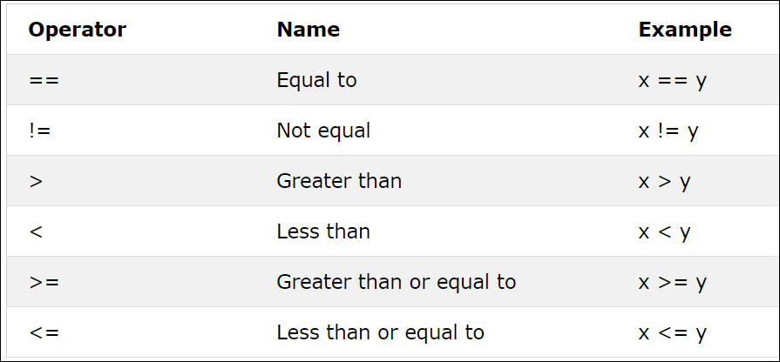
Comparison Operators (Relational)

Slide 16
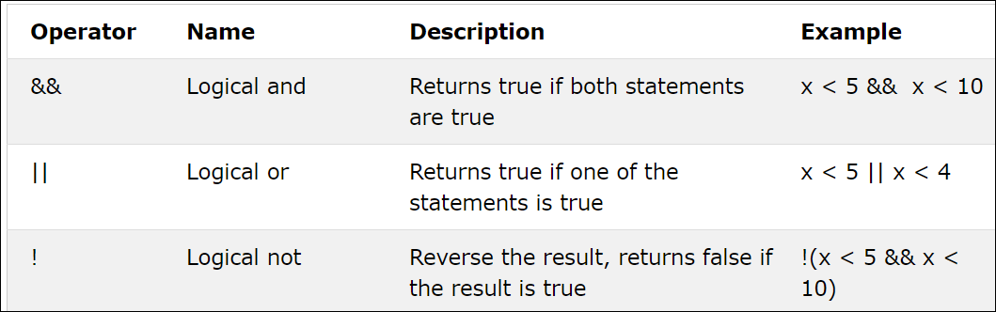
Logical Operators

Slide 17
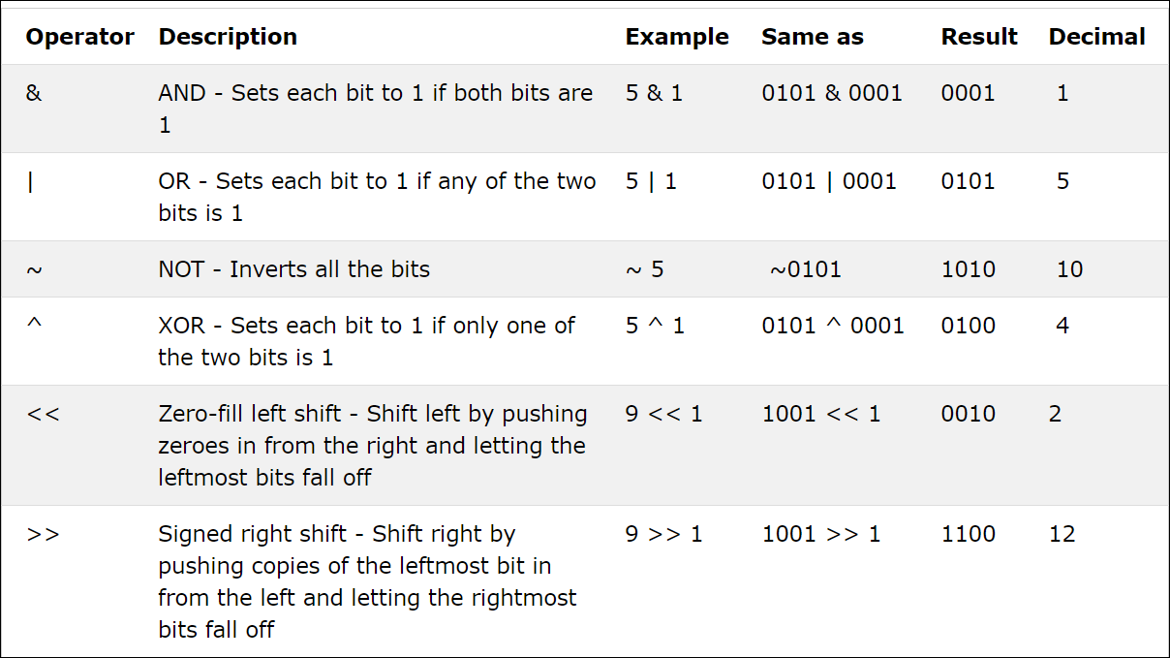
Bitwise Operators

Slide 18
Java Ternary Operator
Java Ternary operator is used as one liner replacement for if-then-else statement and used a lot in Java programming.
It is the only conditional operator which takes three operands.
class Example
{
public static void main(String args[])
{
int a=5;
int b=10;
int min=(a<b)?a:b;
System.out.println(min);
}
}

Slide 19
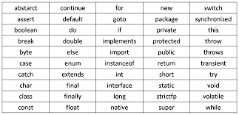
Java Keywords

Slide 20
Home Work
WAP to perform all arithmetic operators on two variables , a=20 and b=5.
WAP to use unary operators and print the value of a++, ++a, b- - and - -b where a=10 and b=15.

